Slide 1
Plasma waves, spectra, and interferometry

Slide 2
Electromagnetic waves
Assume a plane electromagnetic wave:
From Faraday’s equation we obtain
Likewise from we obtain
Therefore, B₁ is always perpendicular to k and E₁.

Slide 3
Whistler waves
Whistler waves electromagnetic waves between f_{LH} and f_{ce}.
Whistlers are circularly polarized (right handed).
Despun spacecraft coordinates
Field-aligned coordinates (z || B₀)
Hodogram of perp. fields

Slide 4
Minimum variance analysis
MVA can be applied to whistler waves.
Since , min. variance direction is || k.
v_{min} = [0.86, -0.13, -0.48]
v_{int} = [0.38, -0.45, 0.81]
v_{max} = [0.33, 0.88, 0.34]
b₀ = B₀/|B₀| = [-0.91, 0.14, 0.39]
λ_{max}/λ_{int} = 1.03
λ_{int}/λ_{min} = 35.5
Wave normal angle is then
Whistler waves propagate along B₀.

Slide 5
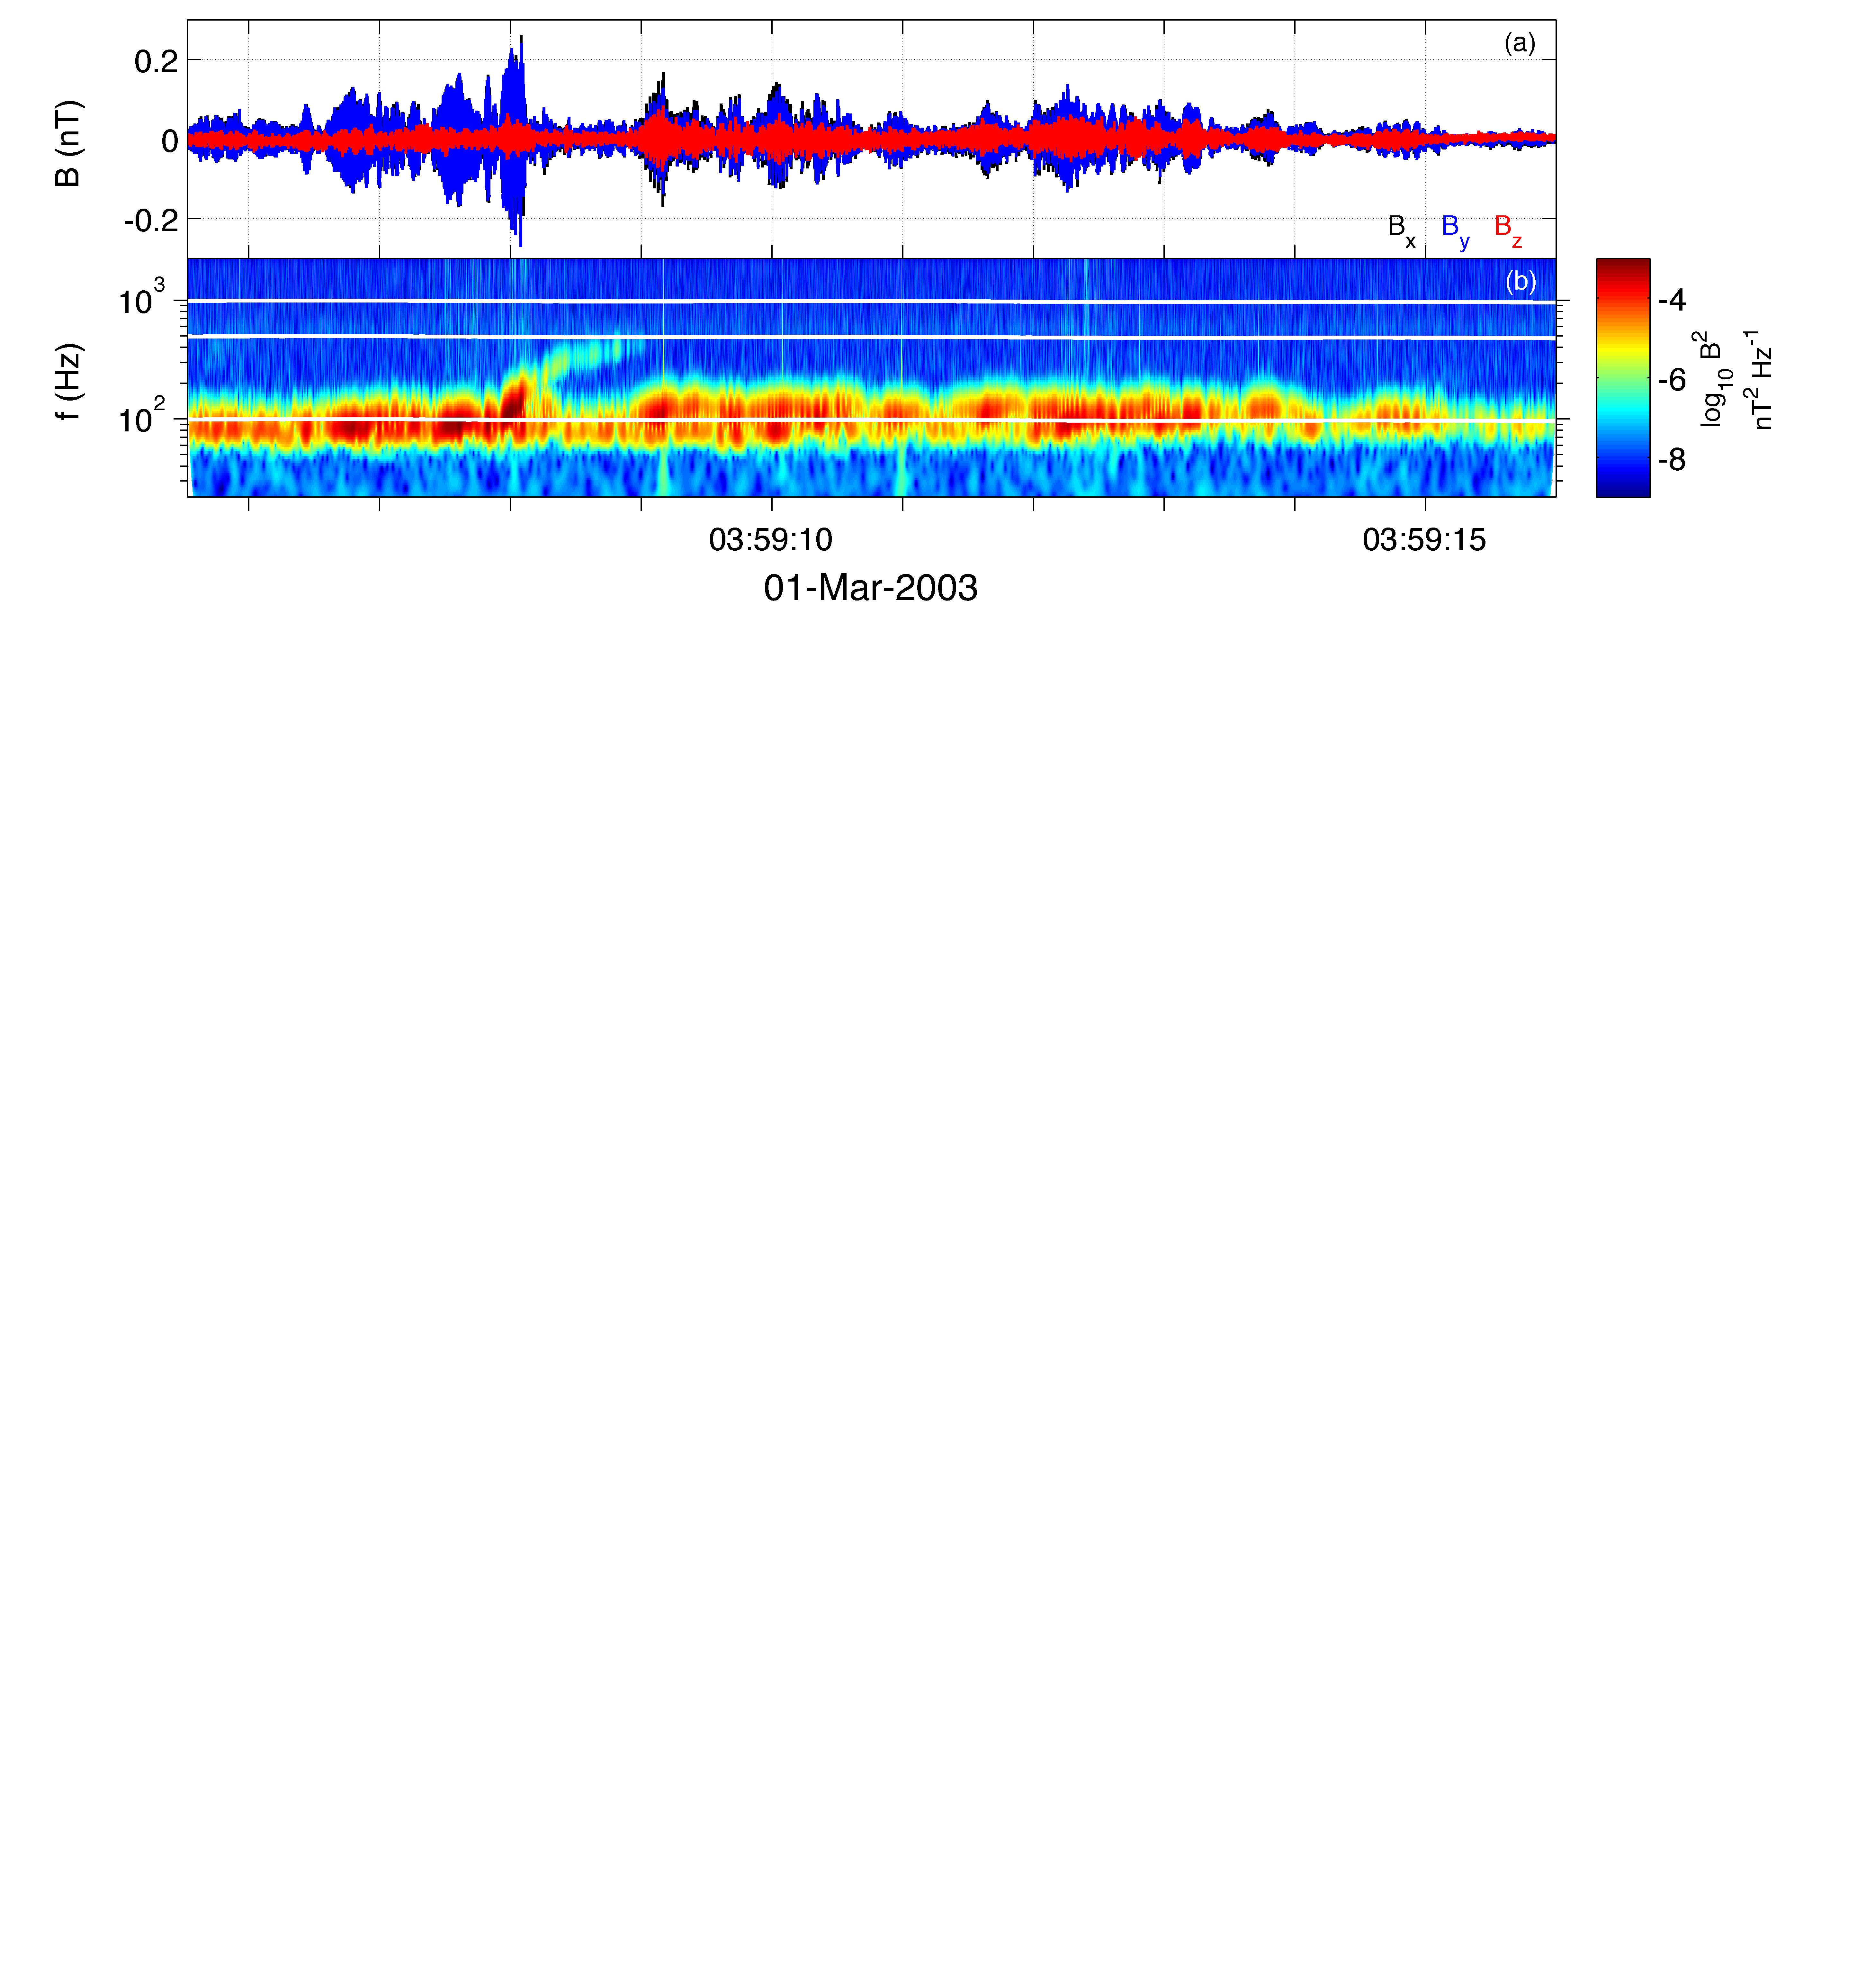
Spectral Analysis
Often observed waves do not have a single frequency (or wave number).
Important to know how wave properties change with frequency, as well as time.
Therefore, spectral analyses are used.
Time series of B.
Wavelet spectrogram of B.

Slide 6
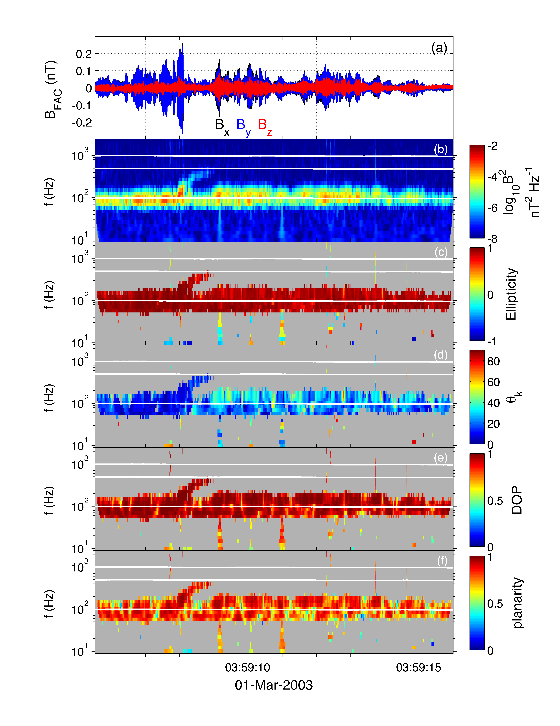
Polarization properties
Spectral analysis techniques can be used to calculate polarization and propagation properties.
From 3D magnetic field: Ellipticity, degree of polarization, wave-normal angle, planarity.
3D magnetic and electric field are used to calculate the Poynting vector.
[Santolik, et al., JGR, 2003]
NB: Cluster only measures E in spin plane. E.B = 0 must be used to estimate Poynting vector.

Slide 7
Example & Exercises
Plotting E and B fields:
>> Bibm = c_caa_var_get('B_Vec_xyz_ISR2__C4_CP_EFW_L2_BB','caa','ts');
>> Eibm = c_caa_var_get('E_Vec_xy_ISR2__C4_CP_EFW_L2_EB','caa','ts');
>> h = irf_plot({Bibm, Eibm});
Scripts plotthetak.m and Bfieldanalysis.m can used to investigate the magnetic field waveforms in detail.
Scripts Bpolarization.m and EBpolarization.m perform spectral analysis.
Exercises:
Plot waveforms of E and B internal burst data (there are 4).
Plot data and find an interesting time interval (e.g. most intense part). Perform MVA and calculate wave normal angle.
Compare wave number angles calculated with MVA and spectral analysis. Do they agree? What do MVA eigenvalues say about ellipticity and planarity?
Compare whistlers observed on 01 March 2003 with 08 March 2004. How do the differ?

Slide 9
Electrostatic Waves and Interferometry
Often electrostatic waves are observed: Electrostatic solitary waves, Langmuir waves, ion-acoustic waves, &c.
Different analysis techniques are required; no magnetic field fluctuations.
We investigate electrostatic waves with E₁ || B₀.
To characterize these waves requires spatially separated measurements of E₁.
Electrostatic waves
ESWs

Slide 10
Interferometry
Typically, electric is calculated from probe combinations p1-p2 and p3-p4.
When individual probe potentials are available, electric fields can be constructed from different probe combinations.
For electrostatic waves we want two E measurements along B₀.

Slide 11
Interferometry
We can construct two E measurements closely aligned with B.
V_{sc} = (V₁+V₂)/2
E₃ = -(V₃-V_{sc})/44m, E₄ = -(V_{sc}-V₄)/44m.
Spacecraft rotation limits the allowable time intervals.
C2 – 2004 March 03
22:40:29.85 UT
E3 and E4 measurements are separated by 44m.

Slide 12
Wave speeds
Wave speeds can be calculated from the time delays between fields.
Time difference between fields is 0.34 ms.
Cross-spectral analysis can be used to calculate f-k power spectrum.
Power follows a linear dispersion relation:

Slide 13
Exercises
Plot E and B fields. Are waves electrostatic? Are there any electromagnetic waves? (B fields available for 25 Feb 2005 and 2007 Apr 10 events).
Find an interesting field-aligned wave event (use getprobeangle.m), select time interval, and plot frequency-wave number spectrum. Estimate speed on the wave.
For the wave event observed between 03:41:35.23--03:41:35.78 UT on 2006 April 28 two modes with distinct speeds are observed. Determine which waves are faster and which are slower.

